Slide 1
Chapter 14 repeat

Slide 2
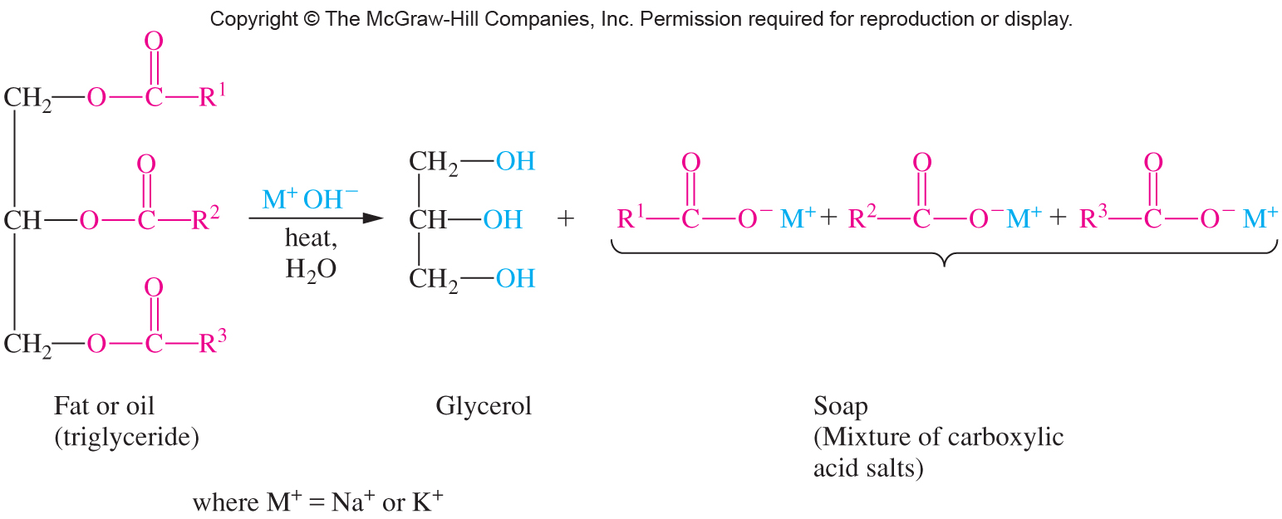
Hydrolysis of fat (saponification)

Slide 3
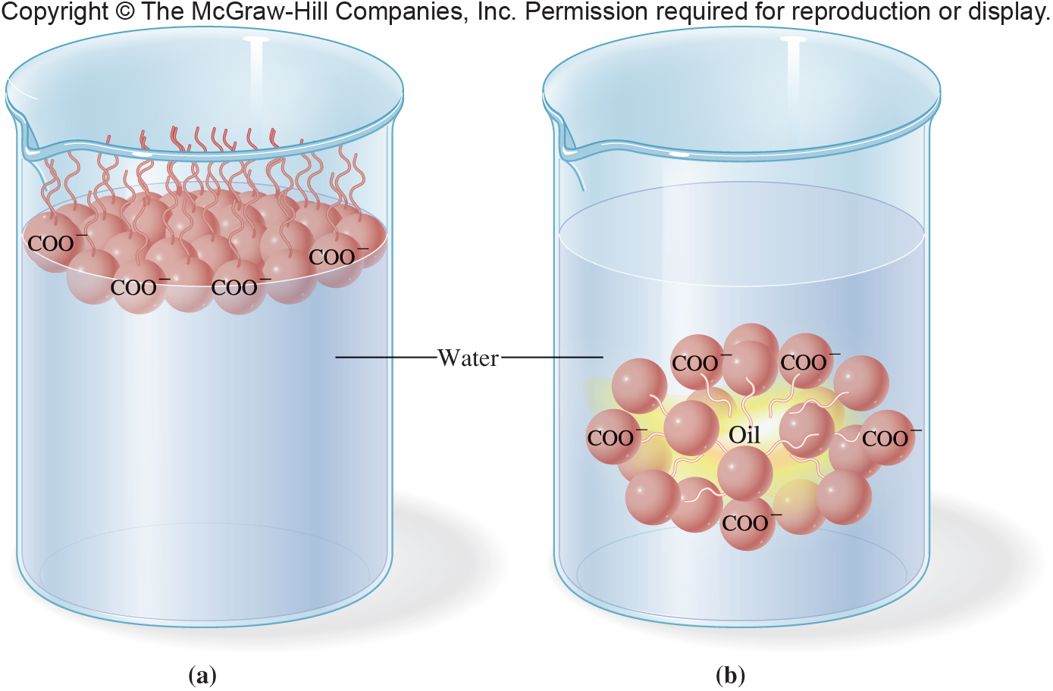
Micelle formation (soap action)

Slide 4
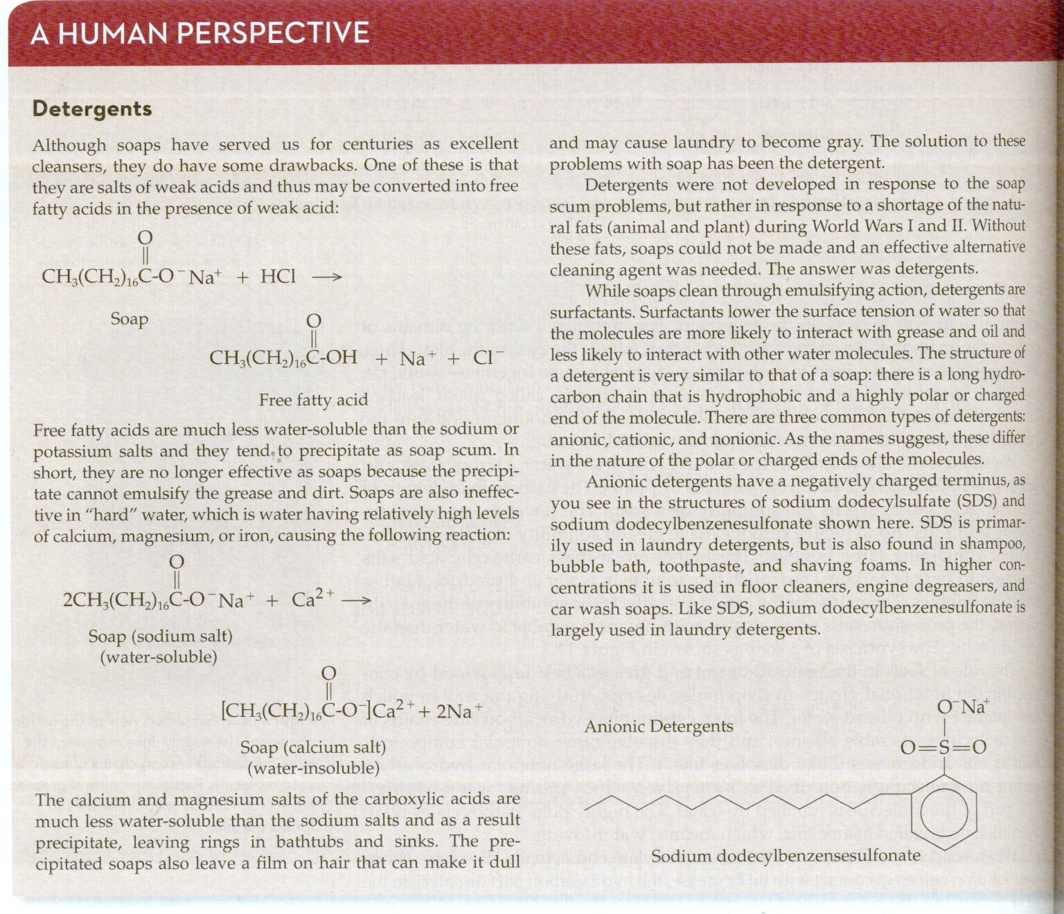
Detergents

Slide 5
Condensation polymers
PETE
PEN

Slide 6
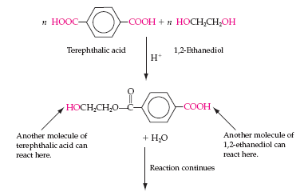
Condensation Polymers
Polyesters are condensation polymers
They are formed by eliminating a small molecule (e.g., H₂O) when combining:
Diacid
Diol
Each of the combining molecules has two reactive functional groups, highlighted in red
14.2 Esters

Slide 7
Polethylene terphthalate, PETE
Terphthalic acid
1,2-ethanediol
PETE is used in:
Mylar
Plastic bottles
Polyester fabric
Continued condensation
at each end
Repeating unit of the polymer

Slide 8
PEN

Slide 9
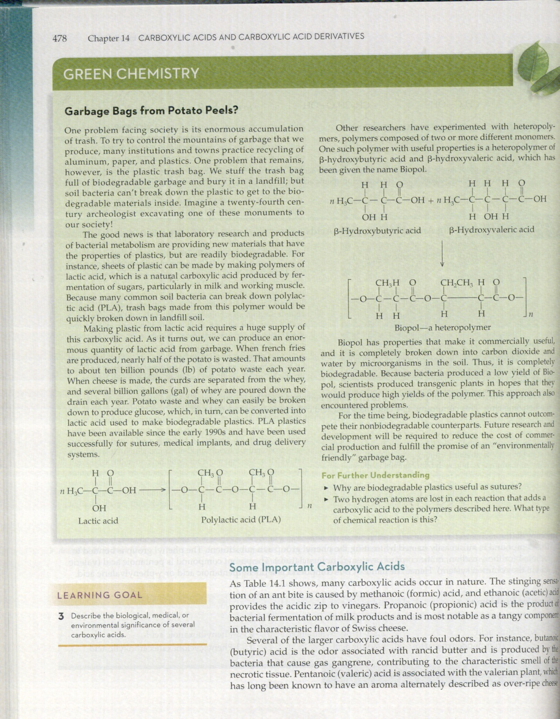
Polymers

Slide 10
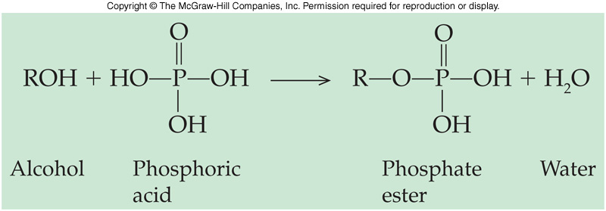
14.4 Nature’s High Energy Compounds: Phosphoesters and Thioesters
15
Phosphoric acid reacts with alcohols to produce a phosphate ester or phosphoester
The ester can then react with a second or third acid to give phosphoric acid anhydrides
ADP and ATP of biochemistry fame are important examples of phosphate esters

Slide 11
Phosphoric Acid Esters
Ester bond
14.4 Nature’s High Energy Compounds: Phosphoesters and Thioesters
Anhydride bonds

Slide 12
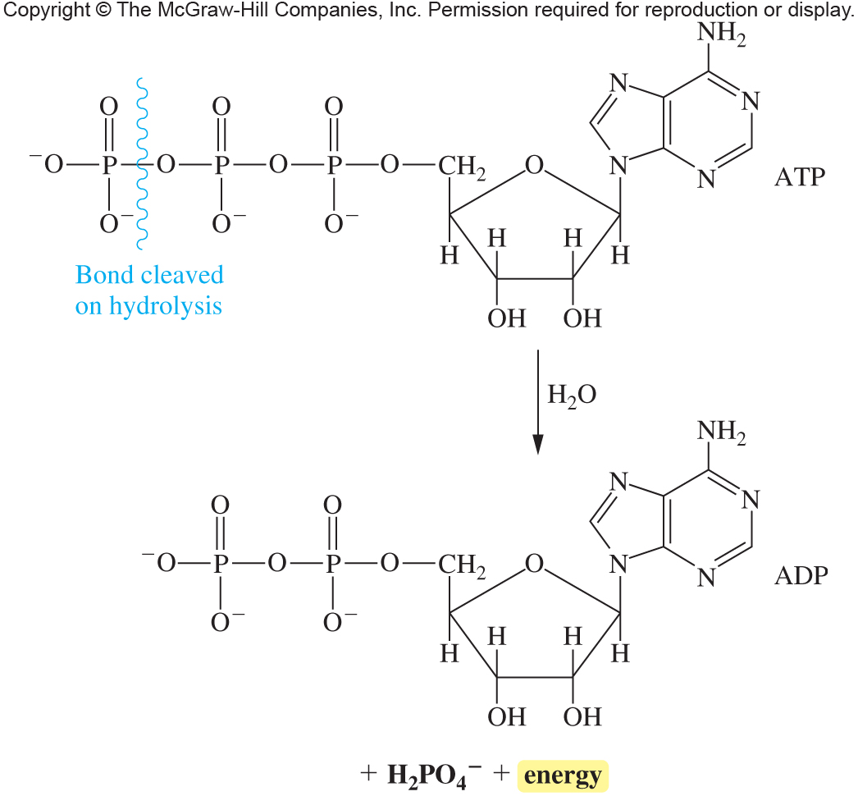
Phosphate esters

Slide 13
Thioesters
In biochemistry, acetyl coenzyme A (acetyl CoA-SH) reacts with acyl groups to “activate” them for further biological reaction by forming a thioester
14.4 Nature’s High Energy Compounds: Phosphoesters and Thioesters

Slide 14
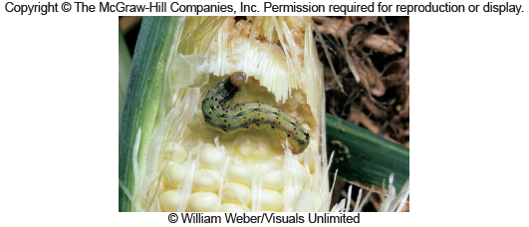
Pheromones

Slide 15
Pain killers

Slide 16
Painkillers and pheromones

Slide 17
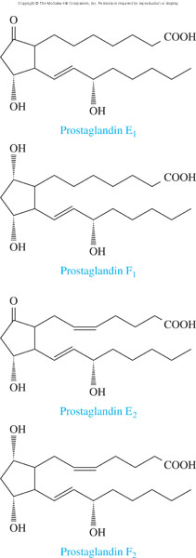
Structures of Four Prostaglandins
17.2 Fatty Acids

Slide 18
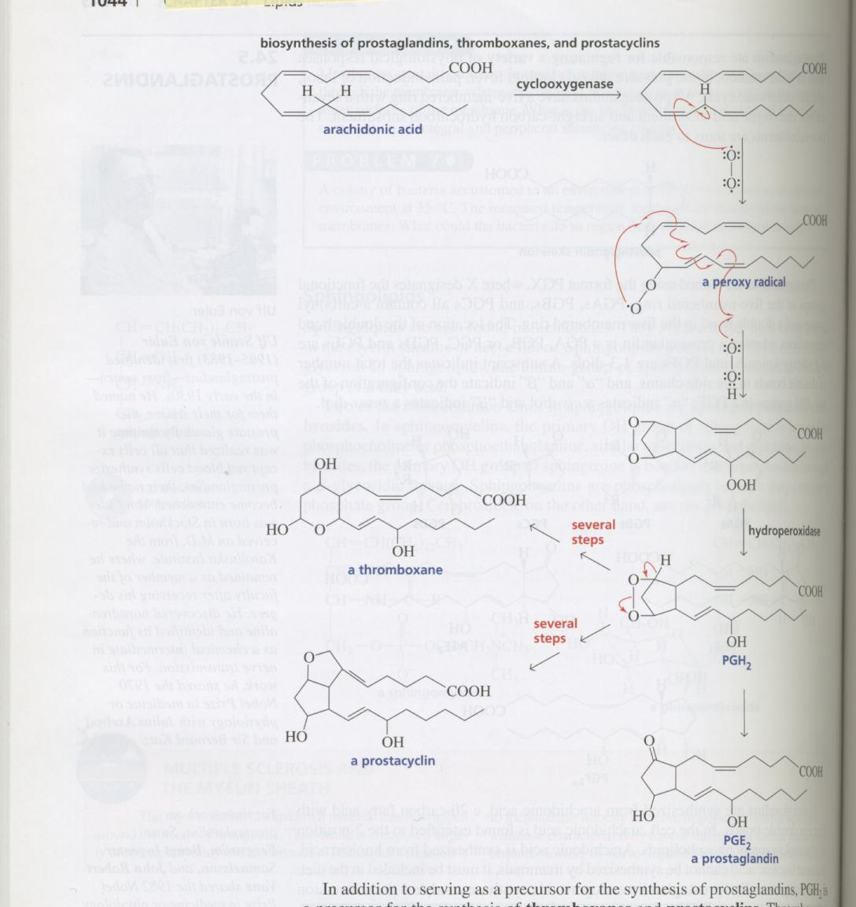
Prostaglandin synthesis

Slide 19
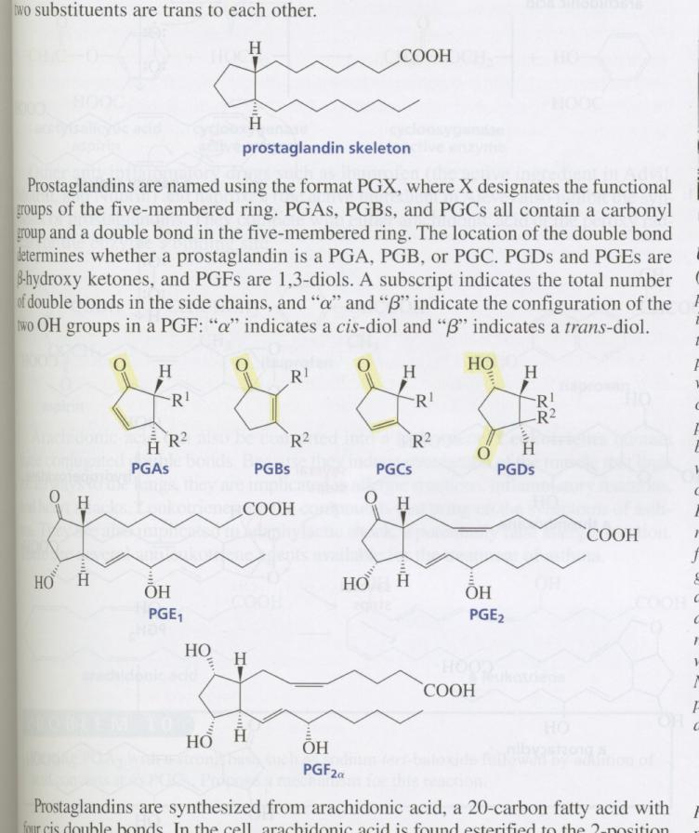
Prostaglandins

